Slide 1
Cortex Cloud
Microsoft Azure Onboarding
Tenant method
Daniel Tor | Senior Solutions Architect Cloud

Slide 2


Slide 3
High level flow
0
1
2
3
4
Pre-work before onboarding
Authorization of Palo Alto Enterprise Application
Create Outpost and deploy
Connect data source Azure to Cortex Cloud
Verify that onboarding is successful
Azure onboarding docs
Always recommend Cloud Scan in POV!
Always recommend onboarding with Terraform!

Slide 4
Azure Permission needed for onboarding? https://docs-cortex.paloaltonetworks.com/r/Cortex-CLOUD/Cortex-Cloud-Runtime-Security-Documentation/Onboard-Microsoft-Azure?tocId=MvDGGRtwdZjW_k8SU7L6yg
Depending on features to enable, different permissions are needed
Owner on Mgmt Group or Subscriptions are not enough!
Example: 'microsoft.aadiam/diagnosticSettings/write' - needed for log ingestion
(Entra ID permission, not a mgmt group/ subscription permission)
User onboarding Cortex Cloud (with log ingestion), should have either of these two roles:
Security Administrator
Global Administrator
Custom Role (CC docs)
Don't forget “az login” for terraform or ARM deployment

Slide 5
Important - Identify as part of step #0
Min 3 Resource Groups will be created
- Outpost
- Onboarding components
- Each subscription
Data Source connection will add 12 Roles to Enterprise Application
Data Source connection will add a lot of roles/associations based on features
Understand customer Regions in use
- Only deploy outpost on a few targeted regions if possible
- Outpost resourcegroup location (!)
- Modify onboarding scripts to use targeted regions
Proactively identify Azure Policy with deny statement
- Customers usually know what they have in place
- E.g Network interface needs to allow public IP association for Outpost Scanner
- E.g Naming convention on resourceGroups
Onboarding relies on Azure policy “DeployIfNotExists” action

Slide 6
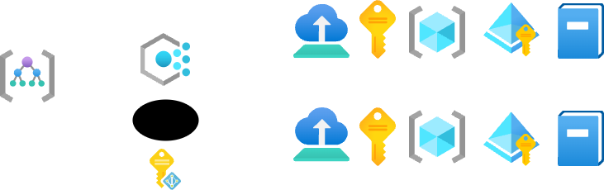
Azure policy “DeployIfNotExists”
Purpose: Maintain visibility and needed infrastructure of all subscriptions, today and tomorrow.
Adding governance layer to protect against human errors, while not giving SaaS-tool (CC) dangerous permissions directly to customer environment.
ResourceGroup
cortex-{suffix}
Subscription A
Azure policy
Tenant Root Group
Remediation
Subscription B
ResourceGroup
cortex-{suffix}
Managed identity
cortex-mi-{suffix}
Important! This will happen on all subscriptions, even if customer only specify Subscription A as included in Cortex

Slide 7
Verify Onboarding - Step #5
Azure policy remediation task is Successful or In Progress
- If failed/ Not Compliant then
- Is the cortex-mi-{suffix} attached to the remediation task? Remediation
- Error message: “PolicyDeploymentFailure ….. was unsuccessful.”
- Verify Deployment log / Activity log on failed Subscription
- Add cortex-mi-{suffix} ObjectId to Azure Policy remediation definition
Verify that all resource groups exists
Verify that all roles + associations exists on Tenant Root Group and 1 Subscription
Verify that Enterprise Application have all Permissions added & granted in Entra ID
Verify that onboarding looks Green in Cortex Cloud
- Data Source
- Outpost

Slide 8
Outpost

Slide 9
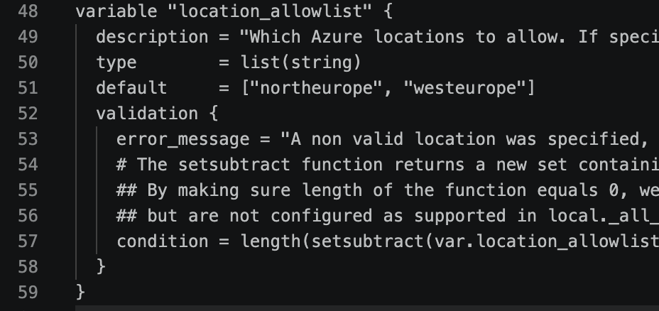
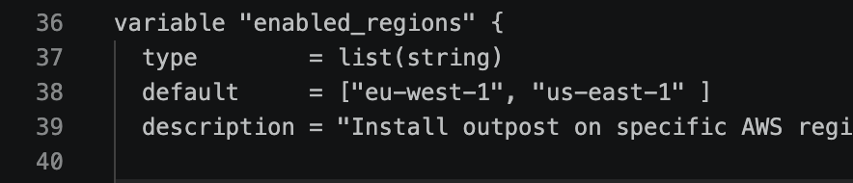
Outpost - Region configuration
Recommended to only deploy Outpost only to the regions in use.
- By default outpost will be deployed to all regions
Azure
Modify schema-input-variables.tf file
AWS
Modify schema-inputs.tf file

